Slide 1






Problem 6.1 P254
(a).
(b).

Slide 2



Problem 6.2 P254
(a)、
(b)、

Slide 3



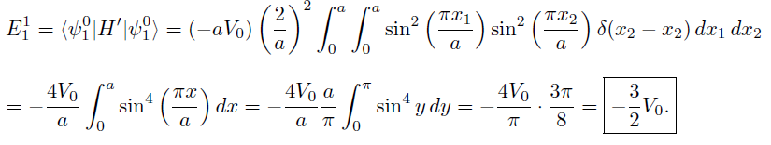
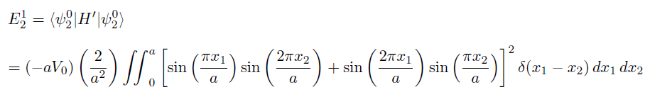

Problem 6.3 P255
(a)、
(b)、

Slide 4





Problem 6.4 P256
(a)、

Slide 5






(b)、

Slide 6






Problem 6.5 P256
(a)、

Slide 7

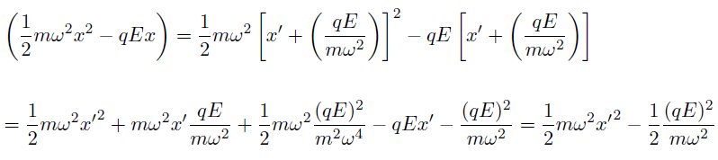


(b)、

Slide 8



Problem 6.7 P260
(a)、problem 2.46
(b)、with a→n,b→-n
eq. 6.26→

Slide 9



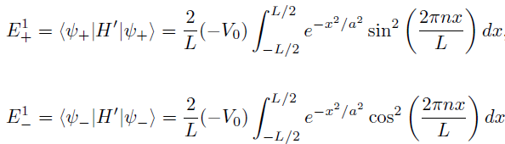


(c)、eq. 6.22→
(c)、eq. 6.9→

Slide 10

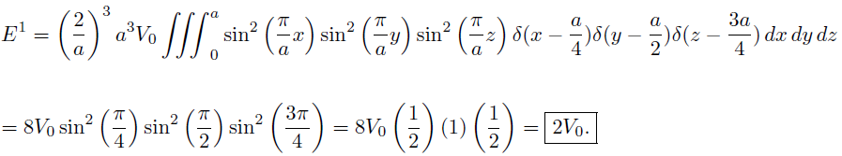
(d)、odd or even parity state, parity operator
Problem 6.8 P265
Ground state

Slide 11
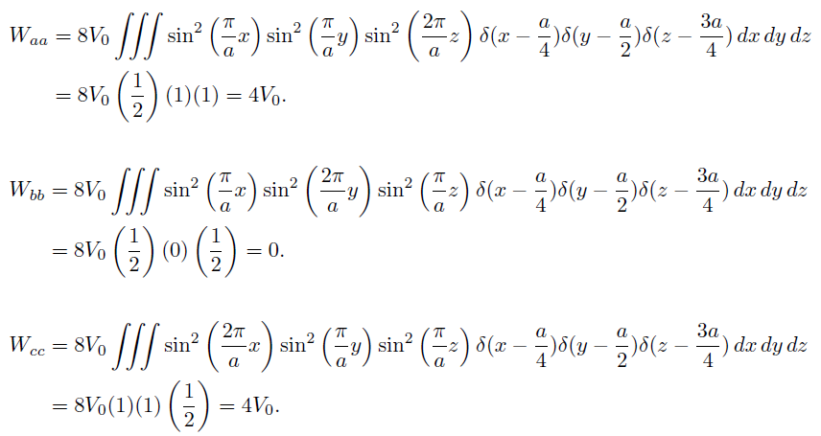
The first excited state

Slide 12

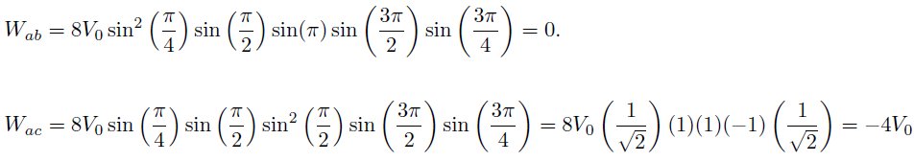


Slide 13



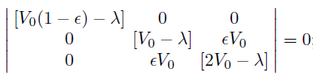



Problem 6.9 P266
(a).
E=V₀
E=V₀
E=2V₀
(b).

Slide 14






(c).

Slide 15


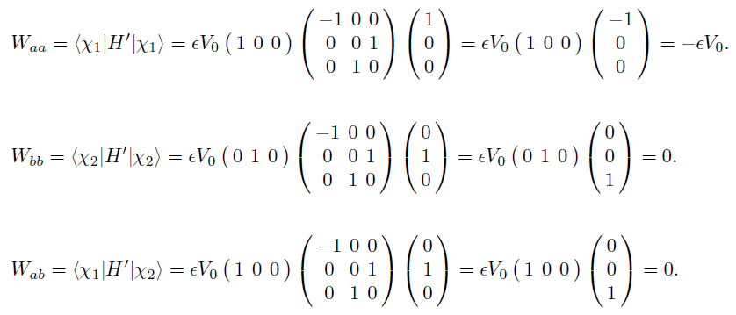
(d).

Slide 16


Slide 17



Problem 6.10 P266

Slide 18





Slide 19
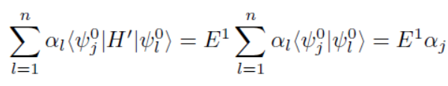

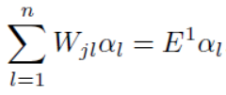

Slide 20
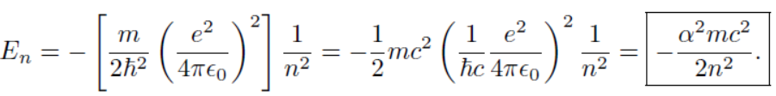
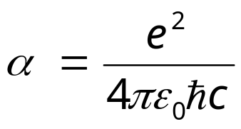
Problem 6.11 P267
(a).
(b).

Slide 21









Problem 6.30 P286
(a).
=0
(b).

Slide 22
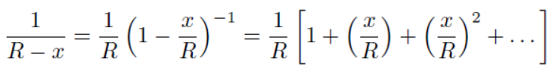


Problem 6.31 P286
(a).

Slide 23
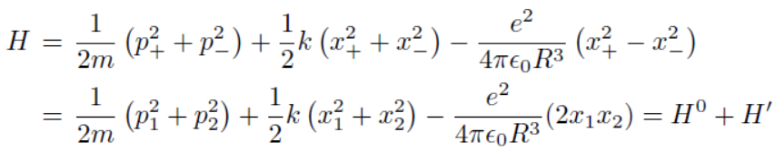
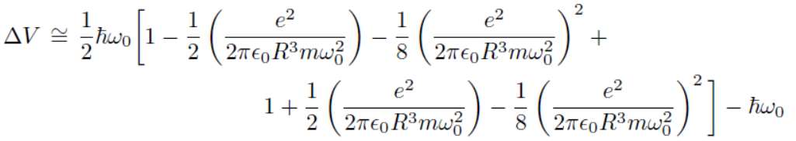

(b).
(c).

Slide 24

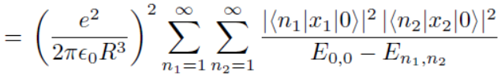
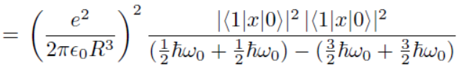


(d).

Slide 25



Problem 6.32 P287
(a).
(b).

Slide 26
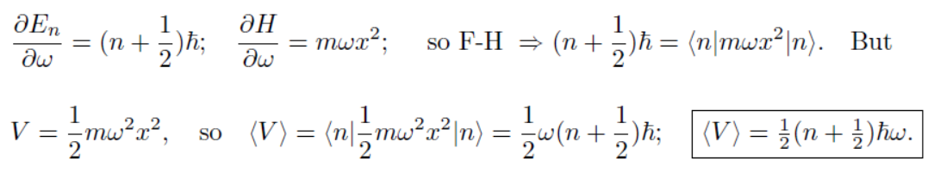
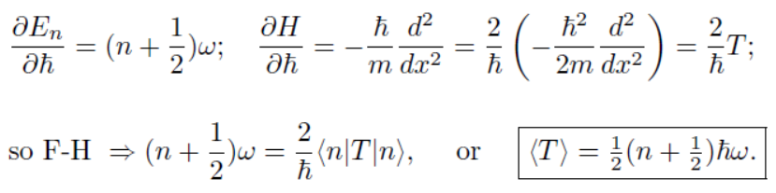


Slide 27








Problem 6.33 P288
(a).
(b).

Slide 28
Homework: problem 6,16,32

